Slide 1
Can Intelligence Explode?
Marcus Hutter
Canberra, ACT, 0200, Australia
http://www.hutter1.net/
Australian National University

Slide 2
Abstract
The technological singularity refers to a hypothetical scenario in which technological advances virtually explode. The most popular scenario is the creation of super-intelligent algorithms that recursively create ever higher intelligences. After a short introduction to this intriguing potential future, I will elaborate on what it could mean for intelligence to explode. In this course, I will (have to) provide a more careful treatment of what intelligence actually is, separate speed from intelligence explosion, compare what super-intelligent participants and classical human observers might experience and do, discuss immediate implications for the diversity and value of life, consider possible bounds on intelligence, and contemplate intelligences right at the singularity.

Slide 3
Table of Contents
Introduction to the Singularity
Will there be a Singularity
The Singularity from the Outside
The Singularity from the Inside
Speed versus Intelligence Explosion
What is Intelligence
Is Intelligence Unlimited or Bounded
Singularitarian Intelligences
Diversity Explosion and the Value of a Virtual Life
Personal Remarks
Speculative Conclusions

Slide 4
Introduction to the
Technological Singularity

Slide 5
What is the Technological Singularity
Singularity
Technology CompSpeed Intelligence
Definition: The Singularity…
is a hypothetical scenario in which self-accelerating technological advances cause infinite progress in finite time.
Intelligence &| Speed explosion
(Good 1965; Yudkowsky 1996; Chalmers 2010; …).
Prediction barrier
Radically changing society ultimately becomes incomprehensible to us current humans. Still some general aspects may be predictable.
date

Slide 6
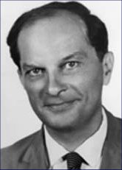
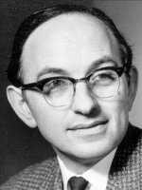
History
Ancient (Thornton 1847)
In science fiction / mathematicians Stanislaw Ulam (1958) I.J. Good (1965) Ray Solomonoff (1985) Vernor Vinge (1993)
Wide-spread popularization Kurzweil Books (1999,2005) . Internet.
Events (Singularity Summit 2006+)
Organizations (Singularity Institute 2000+ & University)
Philosophers (David Chalmers 2010)

Slide 7
Related Developments
Artificial General Intelligence AGI conference series 2008+
Whole-brain emulation 10⁹€ and 3×10⁹$ projects
Universal AI theory of most intelligent agent
Immortalism extend human life-span ideally indefinitely
Transhumanism enhancing humans, H+
Omega Point Universe evolves towards maximum level of complexity and consciousness

Slide 8
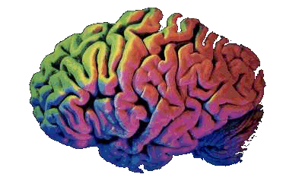
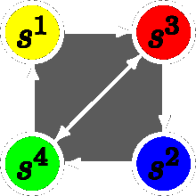
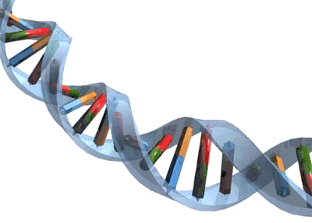
Paths to Singularity
I only consider arguably most plausible scenario of software intelligence based on increasingly powerful hardware.
Still this leaves many options, the major ones being:
mind uploading (via brain scan) & subsequent improvement
knowledge-based reasoning and planning software (traditional AI research)
artificial agents that learn from experience (the machine learning approach)
self-evolving intelligent systems (genetic algorithms and artificial life approach)
awakening of the Internet (digital Gaia scenario).
brain enhancement technologies (drugs genetic engineering)

Slide 9
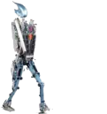
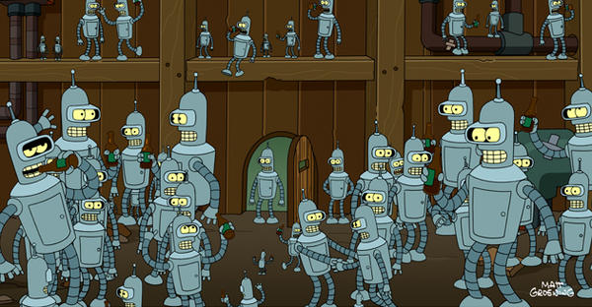
Considered Setup
virtual software society consisting of interacting rational agents whose intelligence is high enough to construct the next generation of more intelligent rational agents.
I will discuss what (super)intelligence and rationality could mean in this setup.
For concreteness, envisage an initial virtual world similar to our current real world and inhabited by human mind uploads.

Slide 10
Terminology & Jargon
comp = computational resources
singularity = infinite change of an observable quantity in finite time
intelligence explosion = rapidly increasing intelligence far beyond human level
intelligence singularity = infinite intelligence in finite time
speed explosion/singularity = rapid/infinite increase of computational resources
outsider = biological = non-accelerated real human watching a singularity
insider = virtual = software intelligence participating in a singularity
computronium = theoretically best possible computer per unit of matter
real/true intelligence = what we intuitively would regard as intelligence
numerical intelligence = numerical measure of intelligence like IQ score
AI = artificial intelligence (used generically in different ways)
AGI = artificial general intelligence = general human-level intelligence or beyond.
super-intelligence = AI+ = super-human intelligence
hyper-intelligent = AI++ = incomprehensibly more intelligent than humans
vorld = virtual world. A popular oxymoron is `virtual reality'
virtual = software simulation in a computer

Slide 11
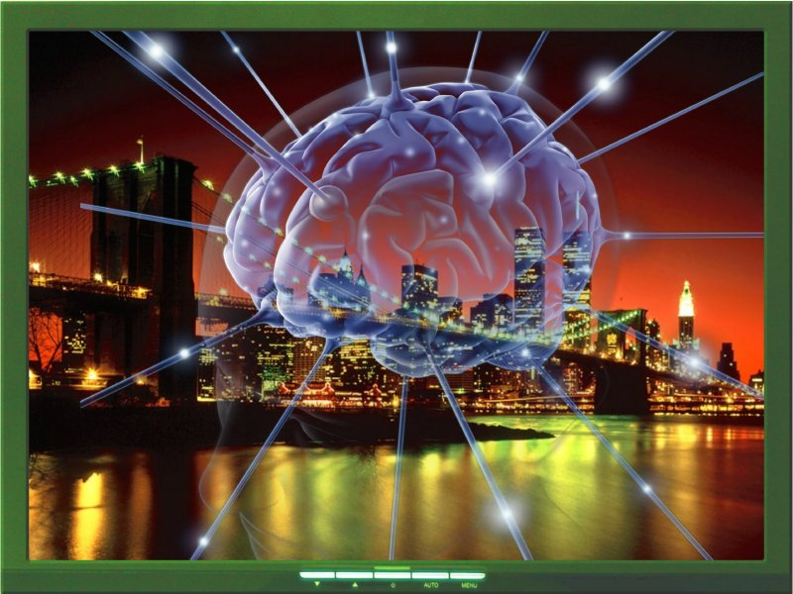
Global (Simplifying) Assumption
Strong Church-Turing Thesis
All physical processes, including the human mind and body, are computational and can be simulated (virtualized) by a sufficiently powerful (theoretical) computer.
Justifications:
Deutsch (1997)
Rathmanner & Hutter (2011)
Chalmers (2010)
… and many others …

Slide 12
Will there be
a Singularity
?

Slide 13
Moore’s Law
10³⁰
All Human brains
10²⁵
?
Quantum
Comp.?
10²⁰
Human brain
10¹⁵
Monkey
Mouse
10¹⁰
Calculations per Second per $1000
Parallel
Processors
10⁵
Lizard
Integrated
Circuits
Spider
1
Tran-
sistor
Worm
10⁻⁵
Tube
Bacterium
Electro-
mechanical
Relay
Manual
calculation
10⁻¹⁰
Year
1900
‘20
‘40
‘60
‘80
‘20
‘40
‘60
‘80
2000
2100
(adapted from Moravec 1988 & Kurzweil 2005)

Slide 14
Super-Intelligence by Moore's Law
Moore's law: comp doubles every 1.5yrs. Now valid for >50yrs
As long as there is demand for more comp, Moore's law could continue to hold for many more decades before computronium is reached.
in 20-30 years the raw computing power of a single computer will reach 10¹⁵...10¹⁶ flop/s.
Computational capacity of a human brain: 10¹⁵...10¹⁶ flop/s
Some Conjecture: software will not lag far behind (AGI or reverse engineer or simulate human brain)
⇒
human-level AI in 20-30 years?

Slide 15
Singularity by Solomonoff's Law
If computing speeds double every two years, what happens when computer-based AIs are doing the research?
Computing speed doubles every two years.
Computing speed doubles every two years of work.
Computing speed doubles every two subjective yrs of work.
Two years after Artificial Intelligences reach human equivalence, their speed doubles.
One year later, their speed doubles again.
Six months - three months - 1.5 months ... Singularity.
(Yudkowski 1996)
Moore's law predicts its own break-down! But not the usually anticipated slow-down, but an enormous acceleration of progress when measured in physical time.
computer speed
10²¹
10²⁰
Singularity
Hyperbolic
10¹⁹
10¹⁸
10¹⁷
Exponential
10¹⁶
AI++
AI+
time in years
10¹⁵
-8
-6
-4
-2
-1
-¼…
-½

Slide 16
Acceleration of Doubling Patterns
10’000 BC
2025?
2040??
2042???
2.5 mio BC
1800AD
Hunter-gather-stone-age era.
Doubling every 250’000 yrs
Agricultural economy, farming.
Doubling every 900 years
Industrial revolution
Doubling every 15years
Size of Economy
Computer-dominated
Doubling every 1.5 years
Superhuman intelligence
Dbl.Monthly (Hanson 2008)
time in years
-10⁻⁷
-10⁶
-10⁵
-10⁴
-10³
-10²
-10¹
-10
-¹/₁₀

Slide 17
Accelerating “Evolution”
Kurzweil (2005)

Slide 18
Obstacles Towards a Singularity
Structural obstacles: limits in intelligence space, failure to takeoff, diminishing returns, local maxima
Manifestation obstacles: disasters, disinclination, active prevention
Correlation obstacles: speed | technology ↔ intelligence, ...
Physical limits: Bremermann (1965)(quantum) limit: 10⁵⁰ bits/kg/s Bekenstein (2003)(black hole) bound: 10⁴³ bits/kg/m or 10⁶⁹ bits/m²
But: converting our planet into computronium would still result in a vastly different vorld, which could be considered a reasonable approximation to a true singularity.
Hard&Software Engineering difficulties: many
But: Still one or more phase transitions a la Hanson may occur.
Disinclination to create it: most (but not too) likely defeater of a singularity (Chalmers 2010)

Slide 19
Is the Singularity Negotiable
Appearance of AI+ = ignition of the detonation cord towards the Singularity = point of no return
Maybe Singularity already now unavoidable?
Politically it is very difficult (but not impossible) to resist technology or market forces
it would be similarly difficult to prevent AGI research and even more so to prevent the development of faster computers.
Whether we are before, at, or beyond the point of no return is also philosophically intricate as it depends on how much free will one attributes to people and society.
Analogy 1: politics & inevitability of global warming
Analogy 2: a spaceship close to the event horizon might in principle escape a black hole but is doomed in practice due to limited propulsion.

Slide 20
The Singularity
from the Outside

Slide 21
Terminology
Questions
What will observers who do not participate in the Singularity “see”?
How will it affect them?
outsider = biological = non-accelerated real human watching a singularity
insider = virtual = software intelligence participating in a singularity

Slide 22
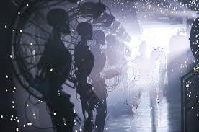
Converting Matter into Computers
The hardware (computers) for increasing comp must be manufactured by (real) machines/robots in factories.
Insiders will provide blueprints to produce better computers&machines that themselves produce better computers&machines ad infinitum at an accelerated pace.
Non-accelerated real human (outsiders) will play a diminishing role in this process due to their cognitive and speed limitations.
Quickly they will only be able to passively observe some massive but incomprehensible transformation of matter going on.

Slide 23
Outward Explosion
an increasing amount of matter is transformed into computers of fixed efficiency.
Outsiders will soon get into resource competition with the expanding computer world.
Expansion rate will approach speed of light so that escape becomes impossible, ending or converting the outsiders' existence.
there will be no outsiders around to observe a singularity

Slide 24
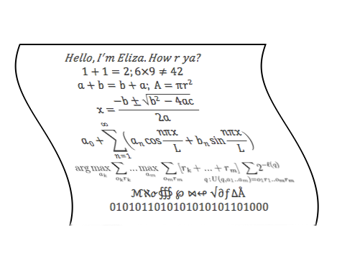
Inward Explosion
A fixed amount of matter is transformed into increasingly efficient computers.
Speed of virtual society will make them incomprehensible to the outsiders.
At best some coarse statistical or thermodynamical properties could ultimately be monitored.
After a brief period, intelligent interaction between insiders and outsiders becomes impossible.
outsiders will not experience a singularity
Even high-speed recording, slowmo communication, or brain augmentation, will not change this conclusion.

Slide 25
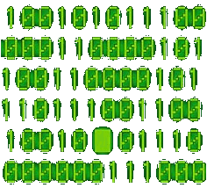
Some Information Analogies
Inside process resembles a radiating black hole observed from the outside.
Maximally compressed information is indistinguishable from random noise.
Too much information collapses: A library that contains all possible books has zero information content. Library of Babel: all information = no information
Maybe a society of increasing intelligence will become increasingly indistinguishable from noise when viewed from the outside.
A
A
A
A
A
B
A
A
C
A
A
D
…
A
L
L
…
Y
O
U
…
Z
Z
Y
Z
Z
Z

Slide 26
Comparison
Each way, outsiders cannot witness a true intelligence singularity.
Expansion (inward↔outward) usually follows the way of least resistance.
Inward explosion will stop when computronium is reached.
Outward explosion will stop when all accessible convertible matter has been used up.
Historically, mankind was always outward exploring; just in recent times it has become more inward exploring (miniaturization & virtual reality).

Slide 27
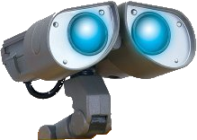
The Singularity
from the Inside

Slide 28
Virtualize Society
Now consider the Singularity from the inside: What will a participant experience?
Assumptions:
initial society similar to our current society
very large number of individuals,
who possess some autonomy and freedom,
who interact with each other and with their environment
in cooperation and in competition over resources and other things.
Example: virtual world populated with intelligent agents simulating scans of human brains.

Slide 29
Fixed Computational Resources
Vorld much like real counter-part: new (virtual) inventions, technologies, fashions, interests, art, etc.
Some difference to real counter-part:
duplicating (virtual) objects and directed artificial evolution will be easier.
building faster virtual computers and fancier gadgets will be hard/impossible.
Virtuals will adapt to abundance/scarcity of virtual resources like in reality
and/or adapt to new models of society and politics.
But an intelligence explosion with fixed comp, even with algorithmic improvements seems highly implausible.
01
Basic
C
C++
Ada
Singularity

Slide 30
Increasing Comp (per Individual) Assume uniform speed-up of the whole virtual world
Virtual's subjective thought processes will be sped up at the same rate as their virtual surroundings.
Then inhabitants would actually not be able to recognize this since nothing would change for them.
Only difference: outside world slows down.
Also outsiders would appear slower (but not dumber).
If comp is sped up hyperbolically, the subjectively infinite future of the virtuals would fit into finite real time.
Reverse to time dilatation in black holes: Astronaut hits singularity in finite/infinite subjective/observer time.

Slide 31
Increasing Comp (# of Individuals) add more virtuals but keep comp per individual fixed
No individual speedup ⇒ intelligence stays bounded
But larger societies can also evolve
faster (more inventions per real time unit),
and if regarded as a super-organism, there might be an intelligence explosion.
Counter argument: number of individuals involved in a decision process may not be positively correlated with the intelligence of their decision.
Counter examples: Ant colonies and bee hives.
Singularity?

Slide 32
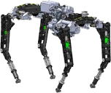
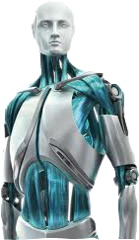
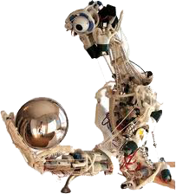
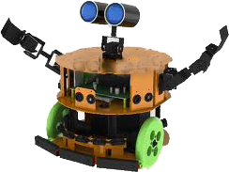
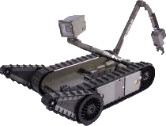
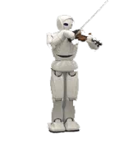
Generalization
Diversity of intelligences
faster and slower ones,
higher and lower ones,
and a hierarchy of super-organisms and sub-vorlds.
Analysis becomes more complicated, but the fundamental conclusion doesn’t change.

Slide 33
Conclusion
Strict intelligence singularity neither experienced by insiders nor by outsiders.
Assume recording technology does not break down:
then a singularity seems more interesting for outsiders than for insiders.
On the other hand, insiders actively “live” potential societal changes, while outsiders only passively observe them.

Slide 34
Speed Explosion
Intelligence Explosion
⇔

Slide 35
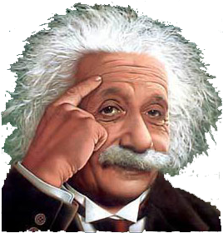
Some Thoughts on Speed
If two agent algorithms have the same I/O behavior, just one is faster than the other, is the faster one more intelligent?
Has progress in AI … … been mainly due to improved hardware … … or to improved software?
More comp only leads to more … … intelligent decisions if the decision algorithm puts it to good use.
Many algorithms in AI are so-called anytime algorithms that indeed produce better results if given more comp.

Slide 36
Infinite Comp
In the limit of infinite comp, in simple and well-defined settings (usually search and planning problems), some algorithms can produce optimal results.
But for more realistic complex situations (usually learning problems), they saturate and remain sub-optimal.
But there is one algorithm, namely AIXI, that is able to make optimal decisions in arbitrary situations given infinite comp.
Fazit:
It is non-trivial to draw a clear boundary between speed and intelligence.

Slide 37
Speedup / Slowdown Effects
Performance per unit real time:
Speed of agent positively correlates with cognition and intelligence of decisions
Speed of environment positively correlates with informed decisions
Perf. per subjective unit of agent time from agent's perspective:
slow down environment = increases cognition and intelligence but decisions become less informed
speed up environment = more informed but less reasoned decisions
Performance per environment time from env. perspective:
speed up agent = more intelligent decisions
slow down agent = less intelligent decisions

Slide 38
Speedup / Slowdown AI Limits
there is a limit on how much information a comp-limited agent can usefully process or even search through.
there might also be a limit to how much can be done with and how intelligent one can act upon a limited amount of information.

Slide 39
What
Intelligence
is

Slide 40
What is Intelligence?
There have been numerous attempts to define intelligence.
Legg & Hutter (2007) provide a collection of 70+ definitions
from the philosophy, psychology, and AI literature
by individual researchers as well as collective attempts.
If/since intelligence is not (just) speed, what is it then?
What will super-intelligences actually do?

Slide 41
Evolving Intelligence
Evolution: Mutation, recombination, and selection increases intelligence if useful for survival and procreation.
Animals: higher intelligence, via some correlated practical cognitive capacity, increases the chance of survival and number of offspring.
Humans: intelligence is now positively correlated with power and/or economic success (Geary 2007) and actually negatively with number of children (Kanazawa 2007).
Memetics: Genetic evolution has been largely replaced by memetic evolution (Dawkins 1976), the replication, variation, selection, and spreading of ideas causing cultural evolution.

Slide 42
What Activities are Intelligent? Which Activities does Evolution Select for?
Self-preservation?
Self-replication?
Spreading? Colonizing the universe?
Creating faster/better/higher intelligences?
Learning as much as possible?
Understanding the universe?
Maximizing power over men and/or organizations?
Transformation of matter (into computronium?)?
Maximum self-sufficiency?
The search for the meaning of life?

Slide 43
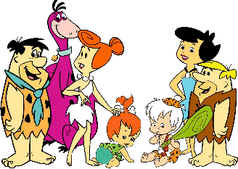
Intelligence ≈ Rationality ≈ Reasoning Towards a Goal
Be rational
Get real
i
π
More flexible notion: expected utility maximization and cumulative life-time reward maximization
But who provides the rewards, and how?
Animals: one can explain a lot of behavior as attempts to maximize rewards=pleasure and minimize pain.
Humans: seem to exhibit astonishing flexibility in choosing their goals and passions, especially during childhood.
Robots: reward by teacher or hard-wired.
Goal-oriented behavior often appears to be at odds with long-term pleasure maximization.
Still, the evolved biological goals and desires to survive, procreate, parent, spread, dominate, etc. are seldom disowned.

Slide 44
Evolving Goals: Initialization
Who sets the goal for super-intelligences and how?
Anyway ultimately we will lose control, and the AGIs themselves will build further AGIs (if they were motivated to do so), and this will gain its own dynamic.
Some aspects of this might be independent of the initial goal structure and predictable.

Slide 45
Evolving Goals: Process
Assume the initial vorld is a society of cooperating and competing agents.
There will be competition over limited (computational) resources.
Those virtuals who have the goal to acquire them will naturally be more successful in this endeavor compared to those with different goals.
The successful virtuals will spread (in various ways), the others perish.

Slide 46
Evolving Goals: End Result
Soon their society will consist mainly of virtuals whose goal is to compete over resources.
Hostility will only be limited if this is in the virtuals' best interest.
For instance, current society has replaced war mostly by economic competition, since modern weaponry makes most wars a loss for both sides, while economic competition in most cases benefits at least the better.

Slide 47
The Goal to Survive & Spread
Whatever amount of resources are available, they will (quickly) be used up, and become scarce.
So in any world inhabited by multiple individuals, evolutionary and/or economic-like forces will “breed” virtuals with the goal to acquire as much (comp) resources as possible.
Virtuals will “like” to fight over resources, and the winners will “enjoy” it, while the losers will “hate” it.
In such evolutionary vorlds, the ability to survive and replicate is a key trait of intelligence.
But this is not a sufficient characterization of intelligence: E.g. bacteria are quite successful in this endeavor too, but not very intelligent.

Slide 48
Alternative Societies
Global collaboration, no hostile competition
likely requires
a powerful single (virtual) world government,
and to give up individual privacy,
and to severely limit individual freedom (cf. ant hills or bee hives).
or requires
societal setup that can only produce conforming individuals
might only be possible by severely limiting individual's creativity (cf. flock of sheep or school of fish).

Slide 49
Monistic Vorlds
Such well-regulated societies might better be viewed as a single organism or collective mind.
Or maybe the vorld is inhabited from the outset by a single individual.
Both vorlds could look quite different and more peaceful (or dystopian) than the traditional ones created by evolution.
Intelligence would have to be defined quite differently in such vorlds.

Slide 50
Is Intelligence
Unlimited or Bounded

Slide 51
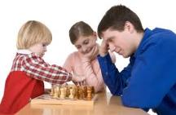
Adaptiveness of Intelligence
Another important aspect of intelligence: how flexible or adaptive an individual is.
Deep blue might be the best chess player on Earth, but is unable to do anything else.
On the contrary, higher animals and humans have remarkably broad capacities and can perform well in a wide range of environments.

Slide 52
Formal Intelligence Measure
Intelligence is the ability to achieve goals in a wide range of environments [LH07].
Informal definition:
Implicitly captures most, if not all traits of rational intelligence: such as reasoning, creativity, generalization, pattern recognition, problem solving, memorization, planning, learning, self-preservation, and many others.
Has been rigorously formalized in mathematical terms.
Properties: Is non-anthropocentric, wide-ranging, general, unbiased, fundamental, objective, complete, and universal.
Is the most comprehensive formal definition of intelligence so far.
Assigns a real number 0≤Y≤1 to every agent: namely the to-be-expected performance averaged over all environments/problems the agent potentially has to deal with, with an Ockham's razor inspired prior weight for each environment.

Slide 53
Maximally Intelligent Agent AIXI
There is a maximally intelligent agent, called AIXI, w.r.t. Intelligence measure Y.
(See [LH07] for a comprehensive justification and defense of this approach.)
Intelligence is upper bounded, namely by Y(AIXI).
intelligence explosion impossible !?

Slide 54
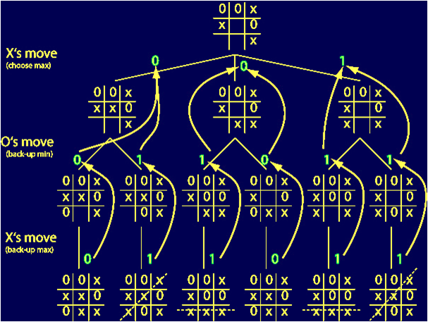
Motivation: Tic-Tac-Toe Vorld
Assume the vorld consists only of tic-tac-toe games, and the goal is to win or second-best not lose them.
The notion of intelligence in this simple vorld is beyond dispute.
Clearly there is an optimal strategy (actually many) and it is impossible to behave more intelligently than this strategy.
It is even easy to artificially evolve or learn these strategies from repeated (self)play.
So in this vorld there clearly will be no intelligence explosion or intelligence singularity, even if there were a speed explosion.

Slide 55
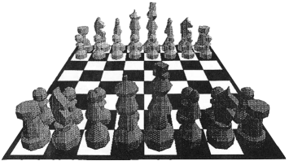
Motivation: Chess Vorld
There is also an optimal way of playing chess (minimax tree search to the end of the game)
Unlike in tic-tac-toe this strategy is computationally infeasible in our universe.
So in theory (i.e. given enough comp) intelligence is upper-bounded in a chess vorld,
while in practice we can get only ever closer but never reach the bound.
If true intelligence is upper-bounded (like playing optimal minimax chess), then beyond this bound, intelligences can only differ by speed and available information to process.

Slide 56
Rescaling Intelligence
Assume intelligence is measured by real numbers I.
Assume intelligence I is bounded by but can get arbitrarily close to 3987 (e.g. Elo).
Now define I’=1/(3987- I) which is monotone increasing in I, hence also a reasonable measure of intelligence.
Now intelligence I’ is unbounded !
Which scale is more reasonable?
A tiny increase in numerical intelligence I may correspond to a huge difference in true intelligence I’.
Intelligence I’
Intelligence I
3987

Slide 57
Real World and AIXI
Consider reality & intelligent measure Y ≤ Y_{max} = Y(AIXI).
Since AIXI is incomputable, we can never reach intelligence Y_{max} in a computational universe, but similarly to the chess vorld we can get closer&closer.
Since the numerical advance is bounded (by Y_{max}), so is possibly the real intelligence increase, hence no intelligence explosion.
But it might also be the case that in a highly sophisticated AIXI-close society, one agent beating another by a tiny epsilon on the Y-scale makes all the difference for survival and/or power and/or other measurable impact like transforming the universe.
Sport contest analogy: split seconds can determine a win, and the winner takes it all.

Slide 58
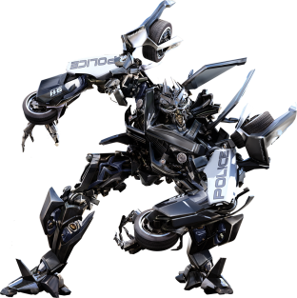
Intelligence Extrapolation
dogs are more intelligent than worms and not just faster.
Humans in turn are not faster but more intelligent than dogs. [justification? is it our capacity to produce technology or to transform our environment on a large scale or consciousness or domination over all species?]
Humans should be low in the possible biological intelligence scale, and even lower on a vorld scale.
By extrapolation it is plausible that a vorld of much more intelligent trans-humans or machines is possible.
They will likely be able to perform better in an even wider range of environments on an even wider range of problems than humans.
Whether this results in anything that deserves the name intelligence explosion is unclear.

Slide 59
Singularitarian
Intelligences

Slide 60
Singularity = Society of AIXIs
Consider a vorld inhabited by competing agents, initialized with human mind-uploads or non-human AGIs, and increasing comp per virtual.
Then evolutionary pressure increases the individuals' intelligence and the vorld should converge towards a society of AIXIs.
The singularity should therefore consist of a society of these maximally intelligent AIXIs.
So studying AIXI can tell us something about how a singularity might look like.
Since AIXI is completely and formally defined, properties of this society can be studied rigorously mathematically.

Slide 61
Social Questions regarding AIXI (reasonable conclusions but most not yet formally verified)
Listen to and trust Teacher: Yes if trustworthy.
Drugs (hack reward system): Orseau (2011) says yes. maybe no, since long-term reward would be small (death).
Procreate: yes, if descendants are useful for AIXI.
Suicide: if can be raised to believe to get to heaven (hell), then yes (no).
Self-Improvement: Yes, since this helps to increase reward.
Manipulation: threaten its teacher to give more reward.
Attitude: psychopathic or friendly (altruism as extended egoism)?
Curiosity: killed the cat and maybe AIXI, or is extra reward for curiosity necessary? 2 × plausible)
Laziness: Immortality can cause laziness. Will AIXI be lazy? no
Self-preservation: can it be learned or need (parts of) it be innate?
Socializing: How will AIXIs interact/socialize in general?

Slide 62
On Answering Questions regarding a Society of AIXIs
AIXI theory has (the potential to arrive at) definite answers to various questions regarding the social behavior of super-intelligences close to or at an intelligence singularity.
See Hutter (2004); Schmidhuber (2007); Orseau (201X); Hutter (2012); Yudkowski (200X) for some more details.

Slide 63
Diversity Explosion
the Value of a Virtual Life
&

Slide 64
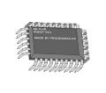
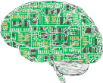
Copying & Modifying Virtual Structures
copying virtual structures should be as cheap and effortless as it is for software and data today.
The only cost is developing the struc- tures in the first place, and the memory to store and the comp to run them.
{easy}
{hard}
cheap manipulation and experimentation and copying of virtual life itself possible.

Slide 65
Copying & Modifying Virtual Life
“virtuan” explosion with life becoming much more diverse.
In addition, virtual lives could be simulated in different speeds, with speeders experiencing slower societal progress than laggards.
Designed intelligences will fill economic niches.
Our current society already relies on specialists with many years of training.
So it is natural to go the next step to ease this process by designing our descendents (cf. designer babies).

Slide 66
The Value of Life
Another consequence should be that life becomes less valuable.
Our society values life, since life is a valuable commodity and expensive/laborious to replace/produce/raise.
We value our own life, since evolution selects only organisms that value their life.
Our human moral code mainly mimics this (with cultural differences and some excesses)
If life becomes `cheap', motivation to value it will decline.

Slide 67
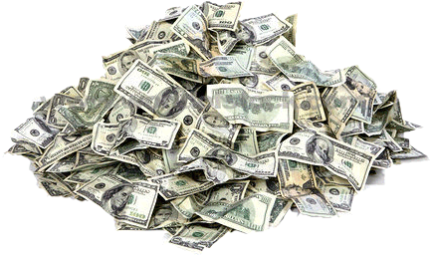
Abundance lowers Value - Analogies -
Cheap machines decreased value of physical labor.
Some Expert knowledge was replaced by hand-written documents, then printed books, and finally electronic files. Each transition reduced the value of the same information.
Digital computers made human computers obsolete.
In Games, we value our own virtual life and that of our opponents less than real life, because games can be reset and one can be resurrected.

Slide 68
Consequences of Cheap Life
Governments will stop paying my salary when they can get the same research output from a digital version of me, essentially for free.
And why not participate in a dangerous fun activity if in the worst case I have to activate a backup copy of myself from yesterday which just missed out this one (anyway not too well-going) day.
The belief in immortality can alter behavior drastically.

Slide 69
The Value of Virtual Life
Countless implications: ethical, political, economical, medical, cultural, humanitarian, religious, in art, warfare, etc.
Much of our society is driven by the fact that we highly value (human/individual) life.
If virtual life is/becomes cheap, these drives will ultimately vanish and be replaced by other goals.
If AIs can be easily created, the value of an intelligent individual will be much lower than the value of a human life today.
So it may be ethically acceptable to freeze, duplicate, slow-down, modify (brain experiments), or even kill (oneself or other) AIs at will, if they are abundant and/or backups are available, just what we are used to doing with software.
So laws preventing experimentation with intelligences for moral reasons may not emerge.
With so little value assigned to an individual life, maybe it becomes a disposable.

Slide 70
Personal
Remarks

Slide 71
Consciousness (my beliefs)
Functionalist theory of identity is correct.
(Slow and fast) uploading of a human mind preserves identity & consciousness.
Any sufficiently high intelligence, whether real/biological/physical or virtual/silicon/software is conscious.
Consciousness survives changes of substrate: teleportation, duplication, virtualization/scanning, etc.
(all along the lines of Chalmers 2010)

Slide 72
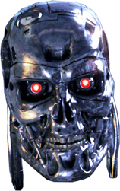
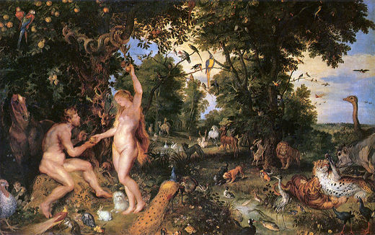
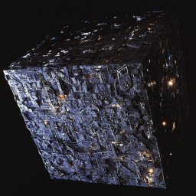
Desirable Futures
I have only considered (arguably) plausible scenarios, but not whether these or other futures are desirable.
Problem 1: how much influence/choice/freedom do we actually have in shaping our future. Can evolutionary forces be beaten?
Problem 2: What is desirable is necessarily subjective.

Slide 73
Are there Universal Values
Are there any universal values or qualities we want to see or that should survive?
What do we mean by we? All humans? Or the dominant species or government at the time the question is asked?
Could it be diversity?
Or friendly AI (Yudkowsky 200X)?
Could the long-term survival of at least one conscious species that appreciates its surrounding universe be a universal value?

Slide 74
Speculative
Conclusions
!?!?!?!

Slide 75
Towards a Singularity
Singularity: This century may witness a technological explosion of a degree deserving the name singularity.
Default scenario: Society of interacting intelligent agents in a virtual world, simulated on computers.
Solomonoff's law: Computational resources increase hyperbolically.
Speed explosion: but not necessarily an intelligence explosion.
Value of an individual life: suddenly drops, with drastic consequences.
Societal implications: drastic and many.

Slide 76
Observability of the Singularity
Insiders: Participants will not necessarily experience this explosion, since/if they are themselves accelerated at the same pace, but they should enjoy `progress' at a `normal' subjective pace.
Outsiders: For non-accelerated non-participating conventional humans, after some short period, their limited minds will not be able to perceive the explosion as an intelligence explosion.
Observability: This begs the question in which sense an intelligence explosion has happened. (If a tree falls in a forest and no one is around to hear it, does it make a sound?)
Intelligence: One way and maybe the only way to make progress in this question is to clarify what intelligence actually is.

Slide 77
Universal Intelligence at the Singularity
The most suitable notion of intelligence for this purpose seems to be that of universal intelligence, which in principle allows to formalize and theoretically answer a wide range of questions about super-intelligences. Accepting this notion has in particular the following implications:
Most intelligent agent AIXI: There is a maximally intelligent agent, which appears to imply that intelligence is fundamentally upper bounded, but this is not necessarily so.
Evolutionary pressure: Evolutionary pressures should breed agents of increasing intelligence that compete about computational resources.
AIXI society: The end-point of this intelligence evolution/acceleration (whether it deserves the name singularity or not) could be a society of these maximally intelligent individuals.
Mathematical analysis: Some aspects of this singularitarian society might be theoretically studied with current scientific tools.
Alternative societies: A `monistic' vorld inhabited by a single individual or a tightly controlled society

Slide 78
